Slide 1
Embedding Adaptivity in Software Systems using the ECSELR framework
Kwaku Yeboah-Antwi
Benoit Baudry

Slide 2
SE Challenges
Hitting complexity wall
Need to automate software engineering
GI improves extant software systems

Slide 3
GI Challenge
Dynamic Adaptivity
Embedding evolution and adaptivity inside extant software systems
Notes:
Self-optimizing systems

Slide 4
Our Contribution
ECSELR
ECologically Inspired Software EvoLution @ Runtime

Slide 5
ECSELR
Dynamic Adaptivity in JVM based systems
Adaptivity driven by environmental changes
Entire framework embedded in software target
Evolution and adaptation in-situ and in-vivo

Slide 6
ECSELR Framework
Choose objects in system to modify
Use operators to mutate previously selected objects
Install the changed objects inside the system
Mutation
Installation
Observation
Selection
Monitor Software System
ECSELR
SOFTWARE
SYSTEM
Notes:
Attaches itself to software system
Starts monitoring system environment
After time period, select objects to perform some action based on previous observation
Mutate objects
Install new mutants in system
Rinse and repeat

Slide 7
ECSELR Implementation
Implemented for JVM languages
Implemented in C
Software
System
JVM
ECSELR
Notes:
We chose JVM because its an intepreted lang and its easier to change dynamically
C because we can manage our memory, resources easily

Slide 8
ECSELR attachment
Inserted into native memory address space
  via JVM attach or native attach mechanism
Manages its own memory
Hooks into JVM and software system

Slide 9
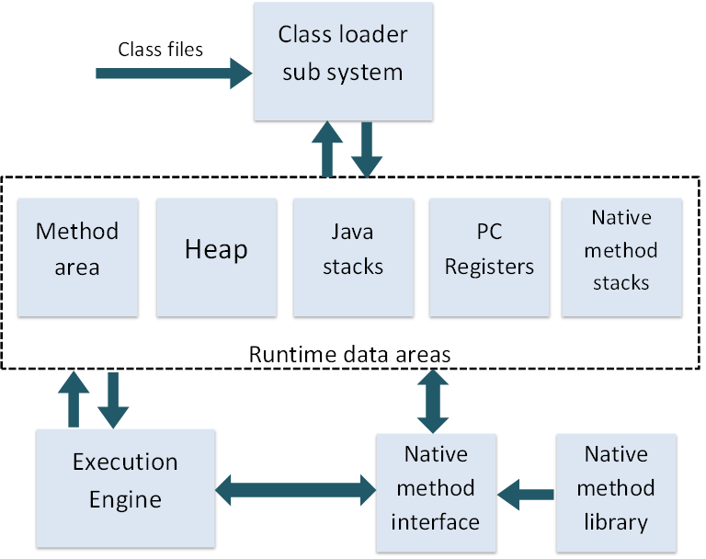
Java Virtual Machine
Notes:
What can ECSELR monitor?
Method Entry/Exit
Stack frame
Field access
Heap
Object Allocation/Deallocation
Class instantiation
Thread creation/death

Slide 10
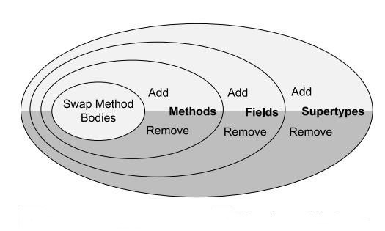
What can ECSELR do?
Notes:
Add or remove bytecode
Merge instructions
Delete instructions
Insert instructions from another location
Add new instructions
Swap instructions

Slide 11
Experimenting with ECSELR
Simplified scenario to demonstrate dynamic adaptation

Slide 12
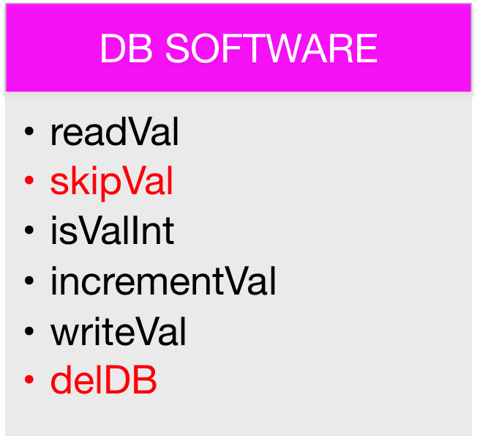
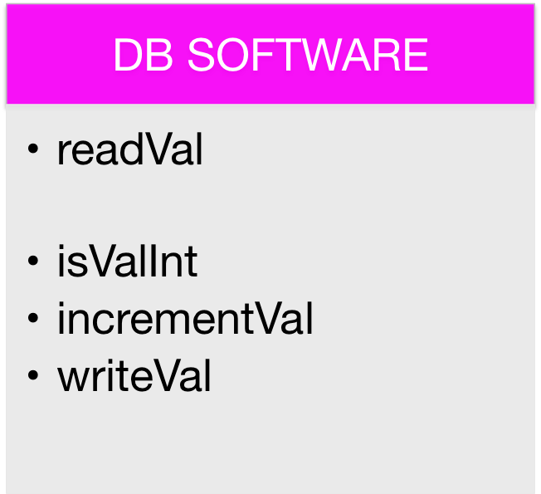
Software Slimming
DB SOFTWARE
readVal
skipVal
isValInt
incrementVal
writeVal
delDB
DB APPLICATION
READ
WRITE
isValInt
incrementVal
readVal
UPDATE
readVal
isValInt
writeVal
Notes:
Remove unused/underutilized components
Not always possible to do statically
Reduce attack surface metric
Reduce resource consumption

Slide 13
Genetic Operators
Merge Objects
Delete Objects
Passthrough Operators

Slide 14
Experiments
Target: Software Slimming
Can ECSELR slim a software system?
Seeking an experimental platform to test this

Slide 15
Experimental Platform Requirements
Should be able to simulate a software system and also simulate realistic interactions in that software system network
Should be able to simulate a stream of interactions so that adaptation/slimming can take place in a live environment

Slide 16
jEvoTestor Experimental Test Platform
Simulates a software system
  Client/server interactions
Tuned using World Cup ‘98 data
Notes:
Client/server interactions between the users of the software system and the system itself

Slide 17
Experimental Platform Data Source
World Cup 98 website trace data
1.3 billion requests interactions
2.8 million unique IPs -> APPS
21,000 unique files -> SERVICES
11,000 requests per hour
88 days of data
All requests time stamped with a resolution of 1 sec
Request volumes vary across time

Slide 18
Experimental Data Parameters
360 components ( classes )
1,000 subcomponents ( methods ) each
360,000 objects in total
27,500 client applications

Slide 19
jEvoTestor Experimental Test Platform
Platform
A
B
C

Slide 20
jEvoTestor Experimental Test Platform
A super agent, “scheduler”, gets all requests for current time.
Informs APP agents about objects they require
APP agents dispatch requests to the PLATFORM agents PLATFORM agents record whether requested services is available or not

Slide 21
PLATFORM AGENTS
Analogous to software platform/server/etc
JAVA class
Provides its java methods as services
Methods correspond to unique objects from data
Performs action if requested objected exists, else returns error

Slide 22
Experiment Protocol
Run for duration of all requests for all APPS
Analyze data

Slide 23
Results
68,084 unique requests
4,907 objects called 1,522,111 times
355,093 objects uncalled (98% of methods)
140,206 objects slimmed
~39.5% of uncalled methods removed
~0.04% objects were removed erroneously

Slide 24
Conclusions
ECSELR – a framework for achieving dynamic adaptivity
Works in-situ and in-vivo
Tested on software slimming
ECSELR is shown to be viable

Slide 25
Take away notes
ECSELR can be paired with other systems to extend its abilities

Slide 26
Validating ECSELR changes or not?
Ignore validation
  System crashes when in error
Automated test generation
Replay previous instructions
Use tests already bundled with system

